Slide 1
Anaplan Data Orchestrator (ADO)
Data INTEGRATION TOOL

Slide 2
Introduction
A built-in Anaplan tool to automate and manage data processes.
Automates Processes – Eliminates repetitive manual work by automatically running data updates and actions.
Schedules Workflows – Ensures the right tasks happen at the right time, in the right order.
Integrates Data – Connects Anaplan models smoothly with your existing systems for consistent and accurate data.

Slide 3
Data Hub Model Approach
Draw backs
Consumes Workspace
Manual integration Processes
Performance reduces while handling large volumes of data
Requires a skilled model builder

Slide 4
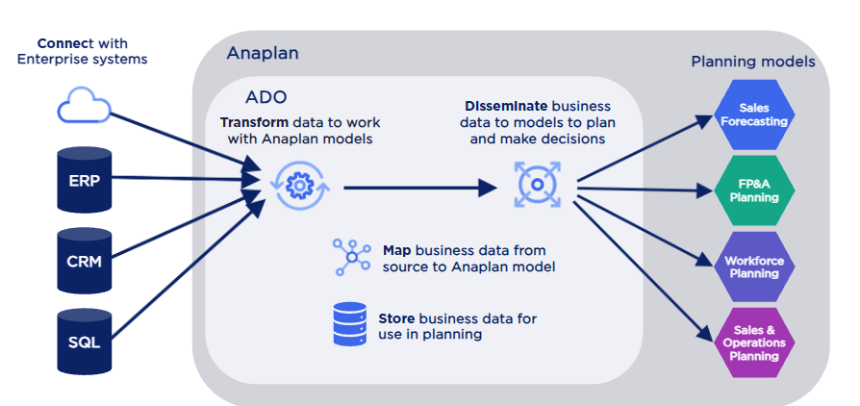
ADO Approach

Slide 5
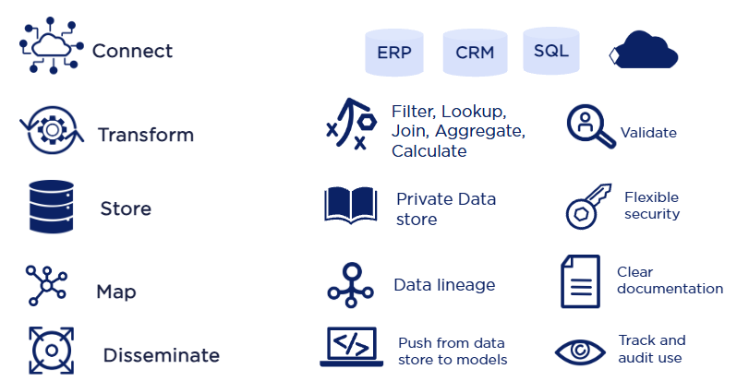
ADO Functionality

Slide 6
Key Comparison
ADO | Data Hub Model
Data stored in tables | Data stored in Modules
Tables, Columns & Rows | Dimensions, Lists, Modules & Line Items
Tenant Level (Customer level) | Workspace Level
Data is pushed in to Spoke model | Data is pulled by Spoke model
Disc based storage with on demand batch processing | Data is in RAM with (in memory) calculation

Slide 7
ADO Benefits
Saves Time – Automates repetitive tasks and data flows.
Reduces Errors – Minimizes manual handling.
Ensures Consistency – Runs processes accurately every time.
Enables Seamless Integration – Connects Anaplan with other systems.

Slide 8
Summary
Reduces manual effort with end-to-end process automation.
Connects Anaplan with external systems in real time.
Scalable Table Based Storage.
Restructures and combines source data for use in Anaplan models.
Saves time, reduces errors, and ensures consistent data updates.

Slide 9
References
Anaplan — Data Management & Integrations Overview of Anaplan’s platform capabilities in data orchestration, integration, and value acceleration Anaplan Inc.
Anapedia — Anaplan Data Orchestrator Detailed documentation (last updated August 4, 2025) covering features like automation, transformation, and integration workflows help.anaplan.com.
Datasheet — Anaplan Data Orchestrator (PDF) A formal capability summary showcasing ADO’s no-code approach, transformation visuals, use cases, benefits, and data lineage insights Anaplan Inc.

